Slide 1
Bit Manipulation & Integer Arithmetics

Slide 2
Outline
Shift and Rotate Instructions (7.1.1 to 7.1.8 KI, Chapter 4 BH)
Applications of Shift and Rotate (7.2.1 and 7.2.2 KI Chapter 4 BH)
Multiplication
Extended Addition/Subtraction

Slide 3
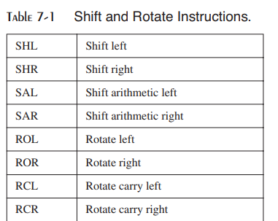
Shift and Rotate Instructions
Bit shifting means to move bits right and left inside an operand.
Instructions are shown in table
All these instructions effect the Overflow and Carry flags.
Syntax
<shift operation > <destination>, <count>
Where count specified the number of shift/rotations
Destination can be reg or mem
Count can be imme or CL

Slide 4



Shift Logical Right (SHR)
Inserts a zero from the left and moves every bit one position to the right and copies the rightmost bit in the carry flag.

Slide 5


Shift Logical Left (SHL) / Shift Arithmetic Left (SAL)
Zero bit is inserted from the right and every bit moves one position to its left with the most significant bit dropping into the carry flag
Notes:
Note that this is *2

Slide 6

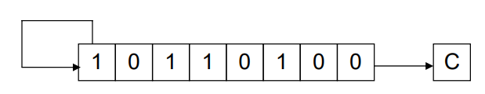
Shift Arithmetic Right (SAR)
Use to handle the signed numbers to retain MSB i.e. sign bit
Shifts every bit one place to the right with a copy of the most significant bit left at the most significant place.
The bit dropped from the right is caught in the carry basket.

Slide 7

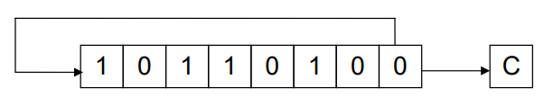
Rotate Right (ROR)
Every bit moves one position to the right and the bit dropped from the right is inserted at the left.
This bit is also copied into the carry flag.

Slide 8
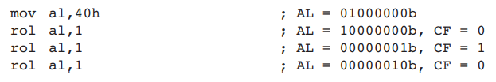
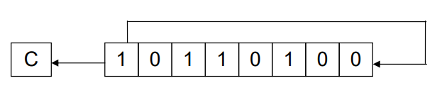
Rotate Left (ROL)
Every bit moves one position to the left and the MSB dropped from the right is inserted at the right.
This bit is also copied into the carry flag.

Slide 9

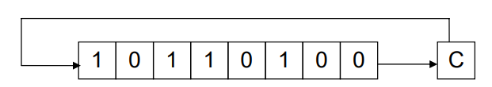
Rotate Through Carry Right (RCR)
The carry flag is inserted from the left
Every bit moves one position to the right.
The right most bit is dropped in the carry flag.

Slide 10

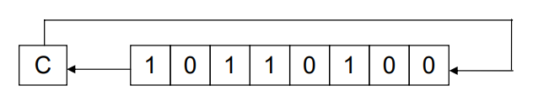
Rotate Through Carry Left (RCL)
The carry flag is inserted from the right
Every bit moves one position to the left.
The left most bit is dropped in the carry flag.

Slide 11
Signed Overflow
The Overflow flag is set if the act of shifting or rotating a signed integer by one bit position generates a value outside the signed integer range of the destination operand.
To put it another way, the number’s sign is reversed.
Examples
a positive integer (+127) stored in an 8-bit register becomes negative (-2) when rotated left:
When –128 is shifted one position to the right, the Overflow flag is set. The result in AL (+64) has the opposite sign
The value of the Overflow flag is undefined when the shift or rotation count is greater than 1
Notes:
mov al, 10001111b
shl al, 1; CF=1 OF=1 because answer was 1 00011110
mov al, 10001111b
shr al, 1; CF=1 OF=1 answer was 01000111 1
clc
;mov al, 01001101b
;shl al, 1; CF=0 OF=1 because answer was 0 10011010
;mov al, 01001101b
;shr al, 1; CF=1 OF=0 answer was 01000111 00100110 1
;mov al, 00001100b
;shl al, 1; CF=0 OF=0
;mov al, 00001100b
;shr al, 1; CF=0 OF=0

